Slide 1
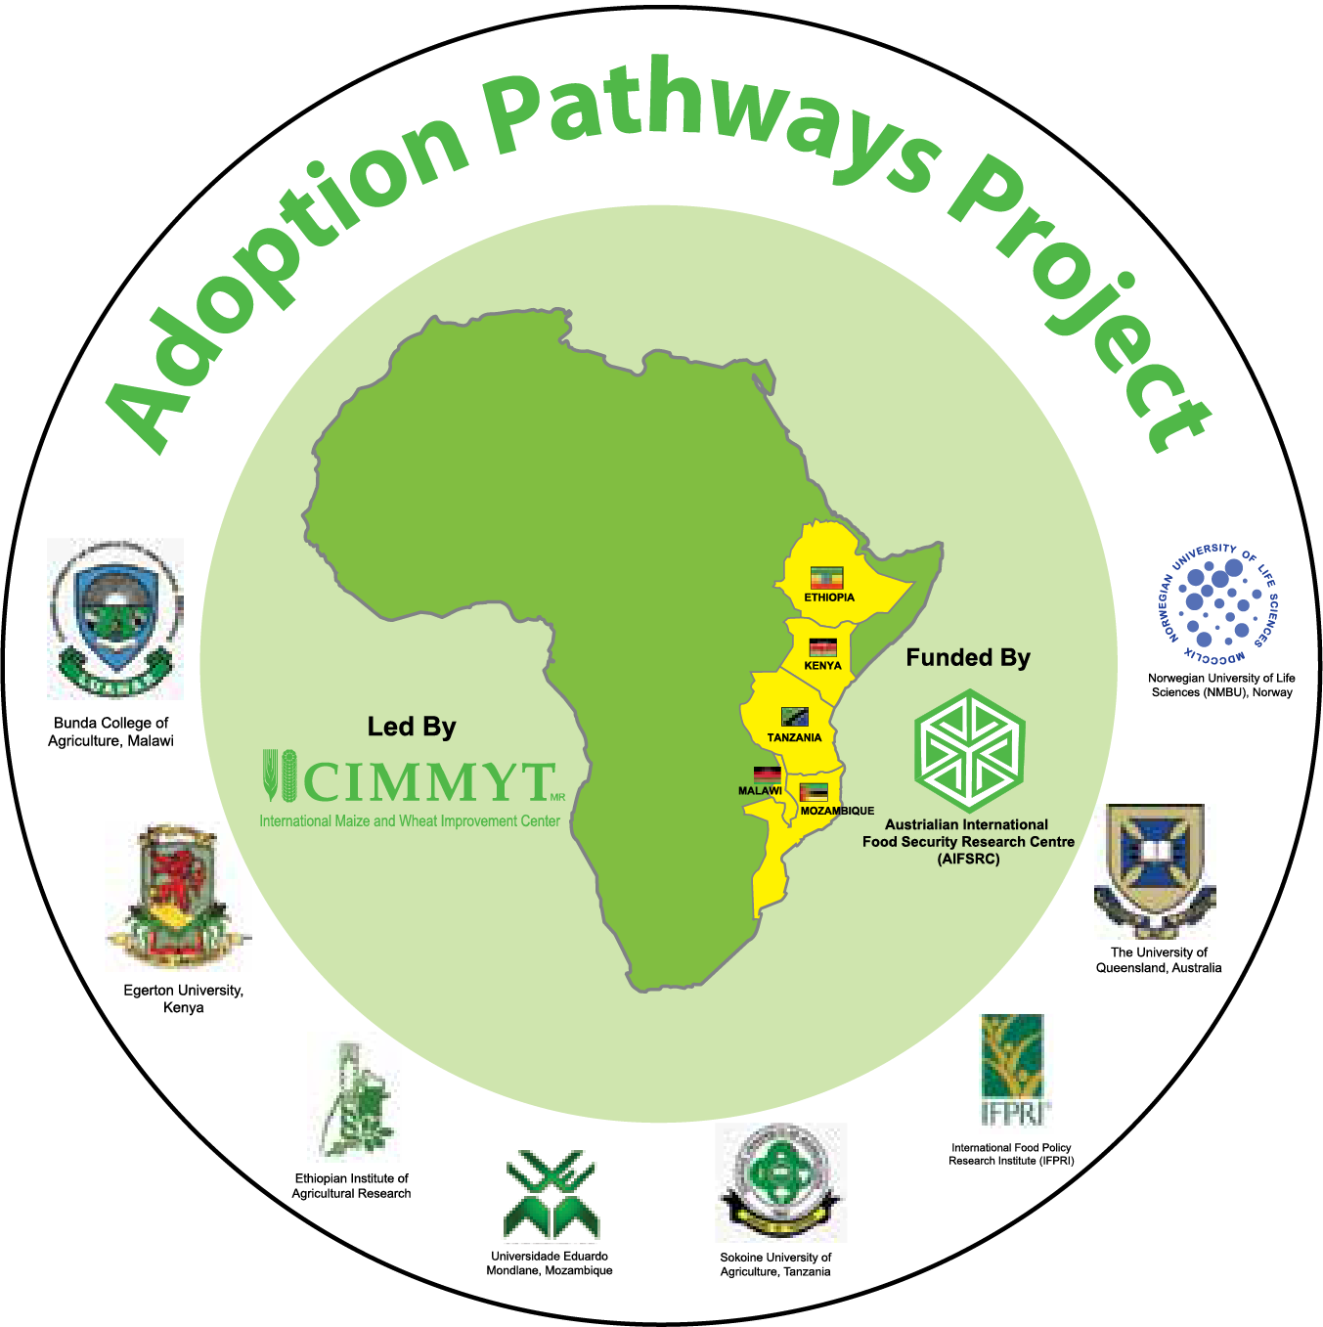
Presentation at the CGIAR Research Program on Maize review meeting
6 October 2014
Addis Ababa, Ethiopia
Menale Kassie, Paswel Marenya, Moti Jaleta and AP partners
Notes:
Four years project: Start date June 2012 and end date May 2016.

Slide 2
Overall objective of Adoption Pathways(AP) Project
Support researchers, decision makers, farmers and development partners in making high quality decisions and research that improve food security…
…by providing appropriate data sets, knowledge base, tools and methods...
…that can be used for better targeting of technologies, accelerating adoption and to understand the dynamics of socio-economic development because of technology and policy interventions…
…within maize farming systems in Eastern and Southern Africa

Slide 3
Four Objectives of the AP Project
Objective 3
Study the impacts
of adoption on
different groups of rural households
1
2
3
Build gender disaggregated data to deepen understanding of technology adoption process
Study the impacts
of adoption on different groups of rural households
Understand farmers’ livelihood in relation to SAI investments and their impacts on adaptation to climate variability and change
4
Enhance the capacity for gender-sensitive agricultural technology policy research and communication of policy recommendations to facilitate adoption of maize system innovations
Notes:
Interlinked objectives

Slide 4
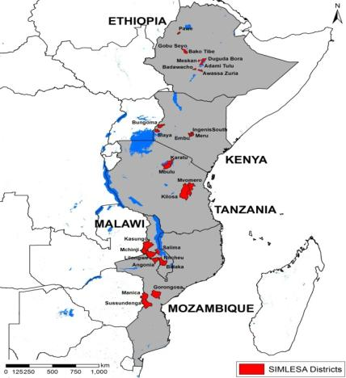
(Five) unique features of the AP Project
Reliance on gender disaggregated panel datasets
Focus on explaining “gender gaps”
  Technology gap
  Productivity gap
  Food security gap
  Income gap
Development of a women empowerment indicator
Analysis of downside risk and technology adoption
Analysis of synergies of joint adoption of technologies
Notes:
Use farmers knowledge and their current framing practices as a starting point for technology development

Slide 5
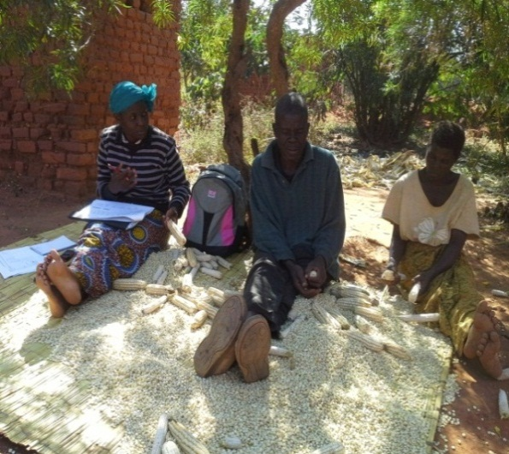
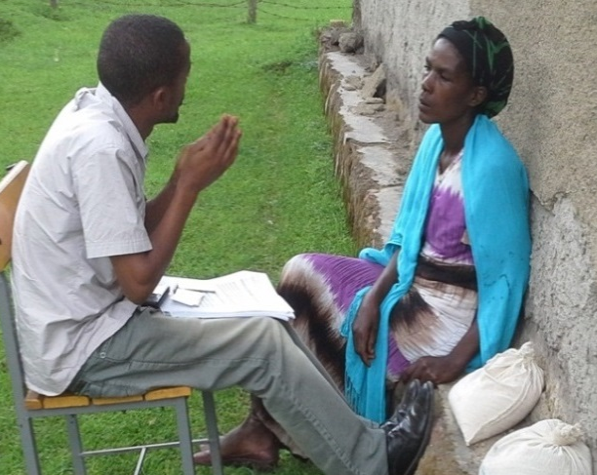
Major Achievements of AP
Major datasets collection completed:
  Gender disaggregated , 4,842 individuals (2, 469 men and 2, 600 women) collected in 2013 and entered
Gender based risk & time preferences experiments carried out in Ethiopia, Kenya, Malawi and Tanzania
Adoption and impacts analysis of SAI published in peer-reviewed outlets
Analysis of Gender, food security and technology adoption published in peer reviewed outlets
Conducted graduate and non-graduate training
  As part of human and institutional capacity enhancement
Outreach and dissemination efforts made
Household level interview in Malawi
Risk & time preferences experiment

Slide 6
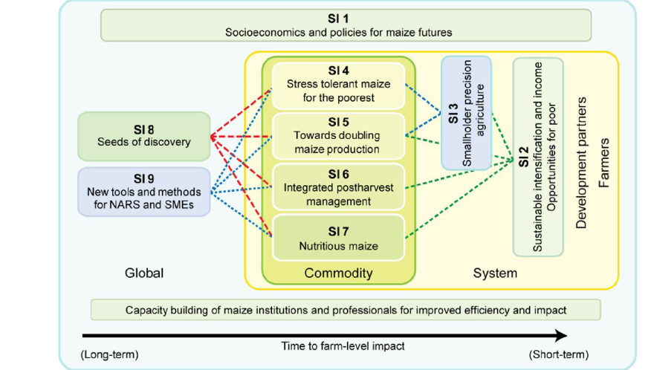
Linkage-CGIAR Research Program on Maize and AP Project
Adoption Pathways (obj. 1 and 3)
Adoption Pathways (obj. 1-4)
Adoption Pathways
(obj 1-3)
Adoption Pathways (obj. 4)
Notes:
Which maize SIs addressed by AP project? It directly contributes to SI 1, SI 2, SI 3, SI 5, capacity development and gender strategies.

Slide 7
Gender, Adoption, and Productivity
(Survey statistics related to some of the SIs)

Slide 8
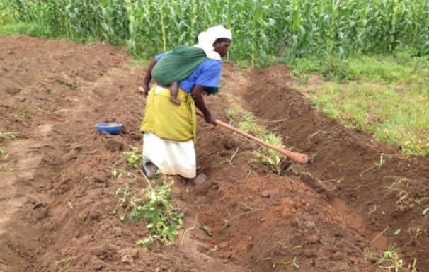
How Much Labor do Women Contribute to Agriculture (SI 1)?
Female labor share by agricultural activity for all crops (%)
Female labor contribution to maize production – 44% (19-55%)
Activity | Ethiopia (N=2257) | Kenya (N=534) | Tanzania (N=551) | Malawi (N=1904) | Mozambique (N=500)
Land preparation & planting | 13 | 48 | 40 | 52 | 45
Weeding | 25 | 50 | 42 | 52 | 53
Harvesting | 26 | 54 | 41 | 54 | 58
Threshing | 28 | 54 | 38 | 61 | 64
Total | 23 | 53 | 43 | 54 | 55
Women’s total labor commitment is disproportionately high
  given that they contribute some 50% of agricultural labor
  plus nearly all the labor required for family care and related household chores.
What intervention(s) can ease the work load of female so that their and their family welfare can be improved?
Notes:
Understanding the role of women in agriculture is important to mainstream technology development and dissemination.

Slide 9
Economic importance of Maize-(SI 1)
Per capita maize consumption
Kenya 125
Ethiopia 138
Malawi 149
Tanzania 168

Slide 10
Technology adoption by gender-(SI 1 + SI 2)
What causes these gaps?
Notes:
Adoption data by varieties are available. Improved maize varieties adoption refers to conditional adoption (i.e. conditional on growing maize).

Slide 11
Sustainable Intensification Practices adoption-(SI 1 + SI2 )
Key findings:
Low adoption of conservation agriculture. What constrained up take of this?
Low SIPs adoption in Ethiopia compared to other countries. What drive this?

Slide 12
Sustainable Intensification practices as adaptation strategy to land constraints -(SI 1 + SI2 )
Crop diversification
Minimum tillage
Maize varieties
Fertilizer
Animal manure
Key findings:
Framers seems to intensify in response to land pressure
Whom shall we target?

Slide 13
Sustainable Intensification practices as adaptation strategy to population pressure-(SI 1 + SI2 )
Key findings:
Framers intensify in response to population pressure except in Kenya

Slide 14
High adoption, low yield. Low adoption, high yield.
Why?
Country | Maize yield (t/ha) | Maize varieties adoption (% hhld) | Fertilizer application for maize plots (kg/ha of nutrients) | Other SIPs adoption
Ethiopia | 3.0 | 63.5 | 50.3 | Low
Kenya | 1.7 | 77.1 | 58.7 | High
Malawi | 1.7 | 69.1 | 79.2 | High
Tanzania | 1.2 | 58.0 | 2.6 | Medium
Question: What explains these apparent trends?
Notes:
Conditional adoption. Conditional on growing maize

Slide 15
Human and institutional capacity development (SI 1, SI 2, SI 5)

Slide 16
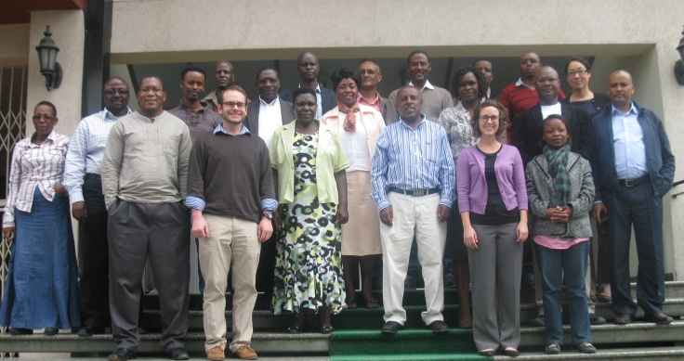
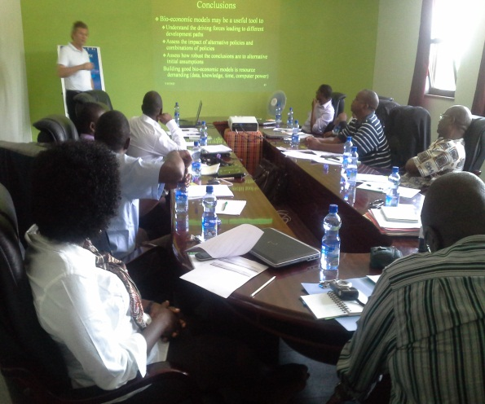
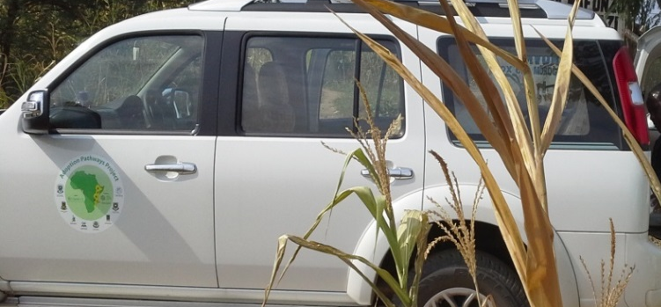
Capacity Development
Gender- integration & analytical analysis and disaggregated data collection training
Methodology training: adoption and impacts,
Risk & household modeling & risk & time preference experiments design
Notes:
Empowering national partner scientists with economic tools and methods of analysis to generate policy relevant maize research products and sustain rigorous economic maize research in Africa

Slide 17
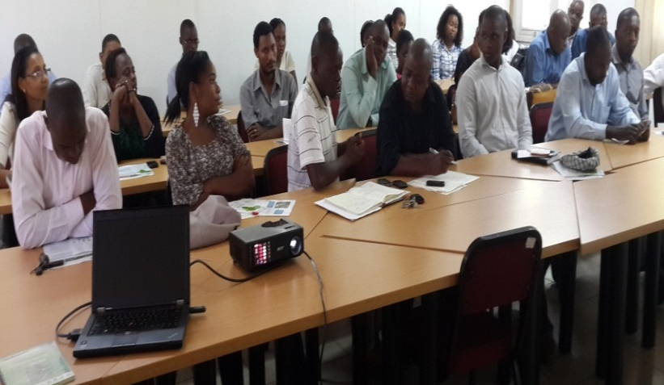
Capacity Development
-PhD and MSc students
9 PhD and 4 MSc students from different African and European countries have used (or are currently using) the data generated by the project for studying various topics:
  Gender and technology adoption,
  Sustainable intensification practices adoption impacts on food security, income and agro-chemical use
  Male and Female Risk preference and maize technology adoption
  Climate adaptation strategies adoption and impacts on food security etc.,
Notes:
Generating new generation of researchers to increase research productivity/intensity and sustain maize and maize related economic research activities in Africa

Slide 18
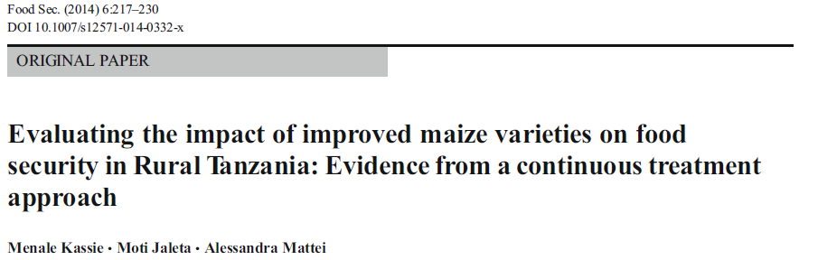
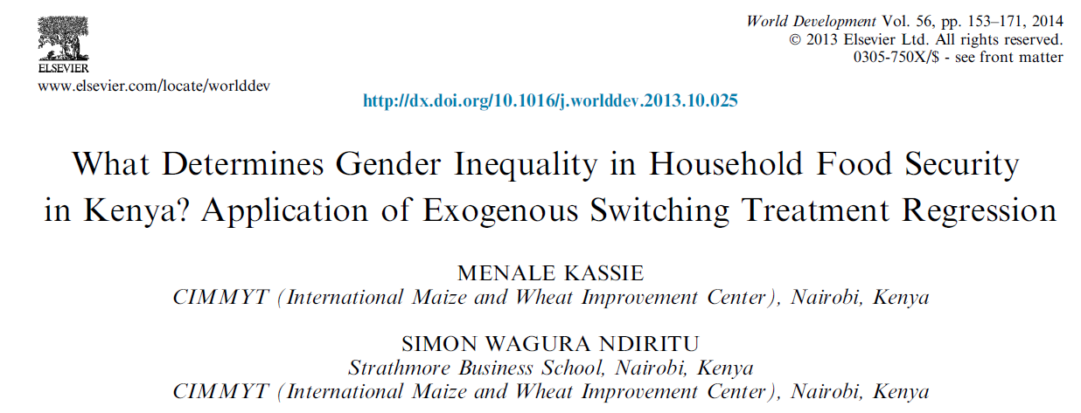
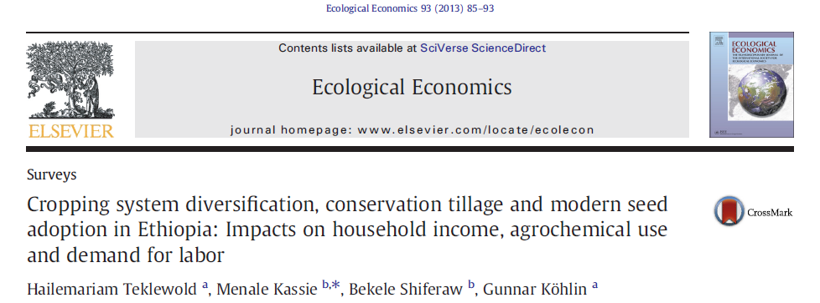
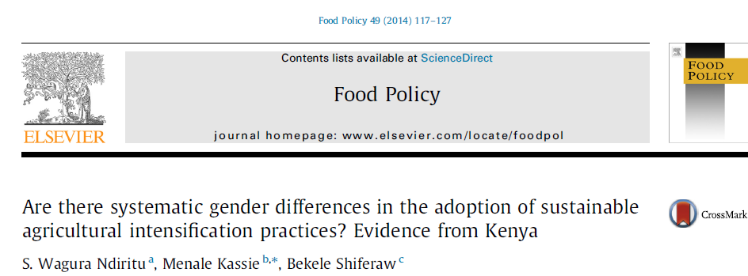
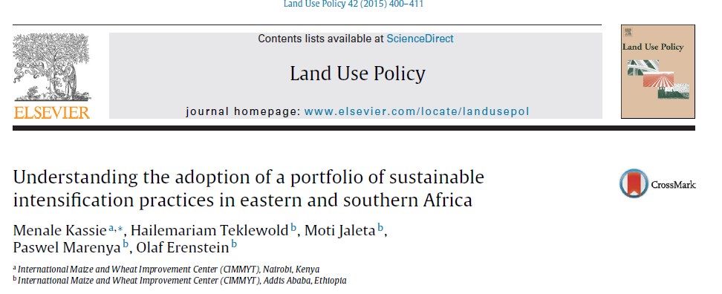
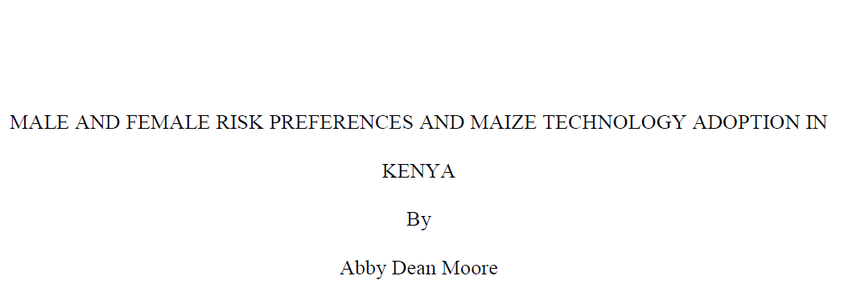
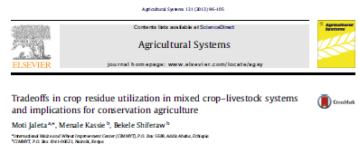

Scientific Publications (SI 1 + SI 2)
Notes:
The tools and knowledge generated can be adapted by partners and beyond

Slide 19

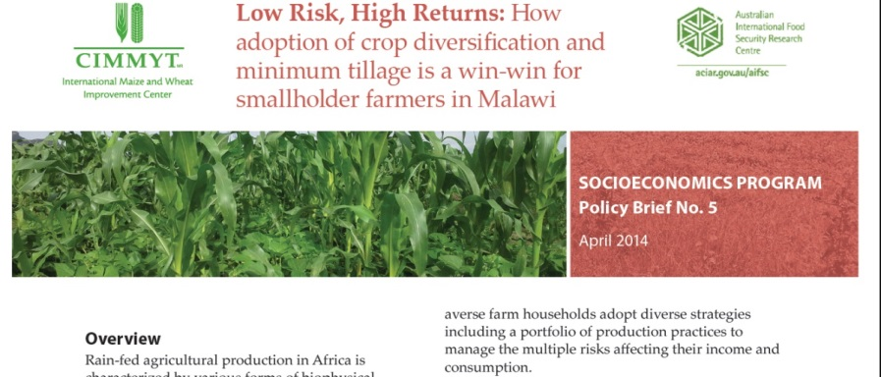
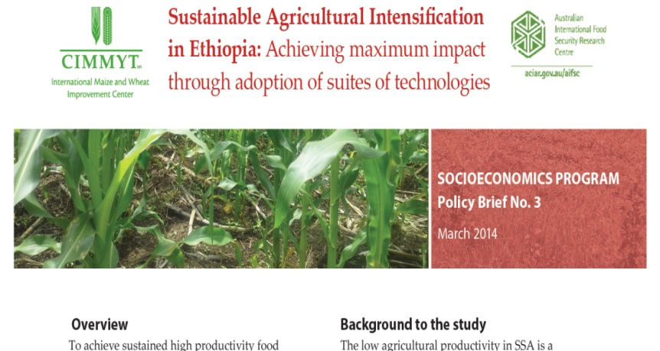
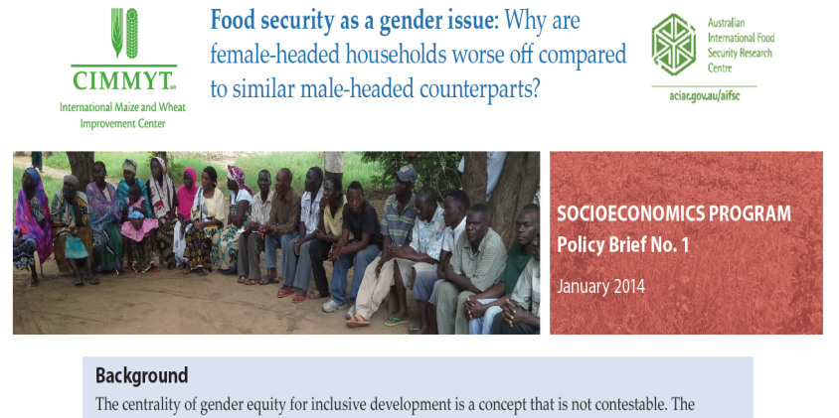
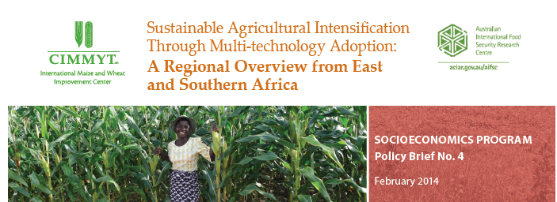

Policy Briefs
Notes:
Empowering decision makers and development partners to generate evidence based policies and undertake informed decision.

Slide 20
Some Empirical Evidence related to SIs

Slide 21
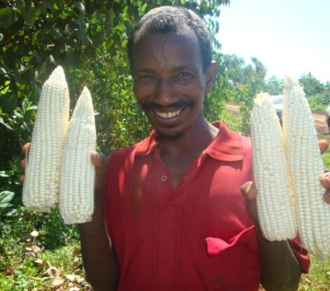
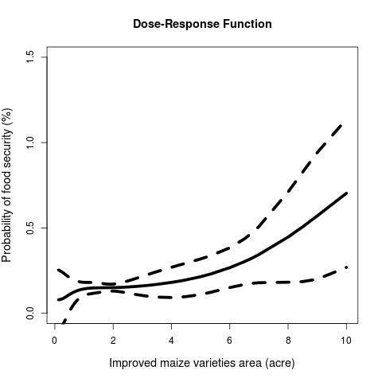
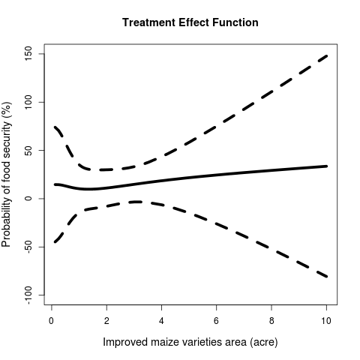
Sustainable Intensification Practices: Food Security Opportunity for the Poor (SI 1, SI 2)
Key findings (binary food security)
Food security significantly increases with area under improved maize variety
Approach helps determine level of maize area required to achieve food security
Source: Food Security (2014) 6:217.-230
Notes:
With more data the contribution of each variety to food security will be analysed. Here we focus on all varieties adopted by farmers in our study areas.

Slide 22
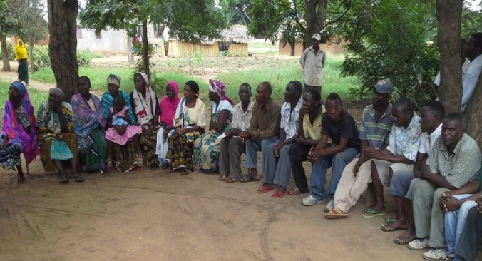
Gender Food Security Gap and Causes- (SI 1+ SI 2)
Key findings
Access to equal input, human capital, technology, land quality, and resources will not close the gender food security gap
Reducing hidden factors can decrease number of food insecure female headed households by 5 %
Source: World Development (2014) 57: 153-171
Notes:
Gender here refers to Male headed- and female headed-households

Slide 23
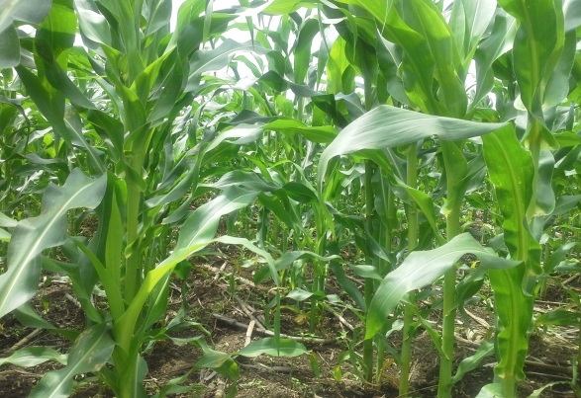
Sustainable Intensification Practices: Income and Food Security Opportunities for the Poor
(SI 1+ SI 2 + SI 5)
Key findings
Combination generate more maize income than single adoption
Maize net income increases by 47-67% when improved maze varieties combined with other SIPs
Maize yield increases by 43-126% when fertilizer combined with MT or CD or both (figure not reported)
Source: Ecological Economics (2013) 93: 85-93
Notes:
MT-minimum tillage and CD-crop diversification (maize-legume intercropping and rotations). Such kind of information will help in designing agronomy and breeding experiments and formulating extension messages.

Slide 24
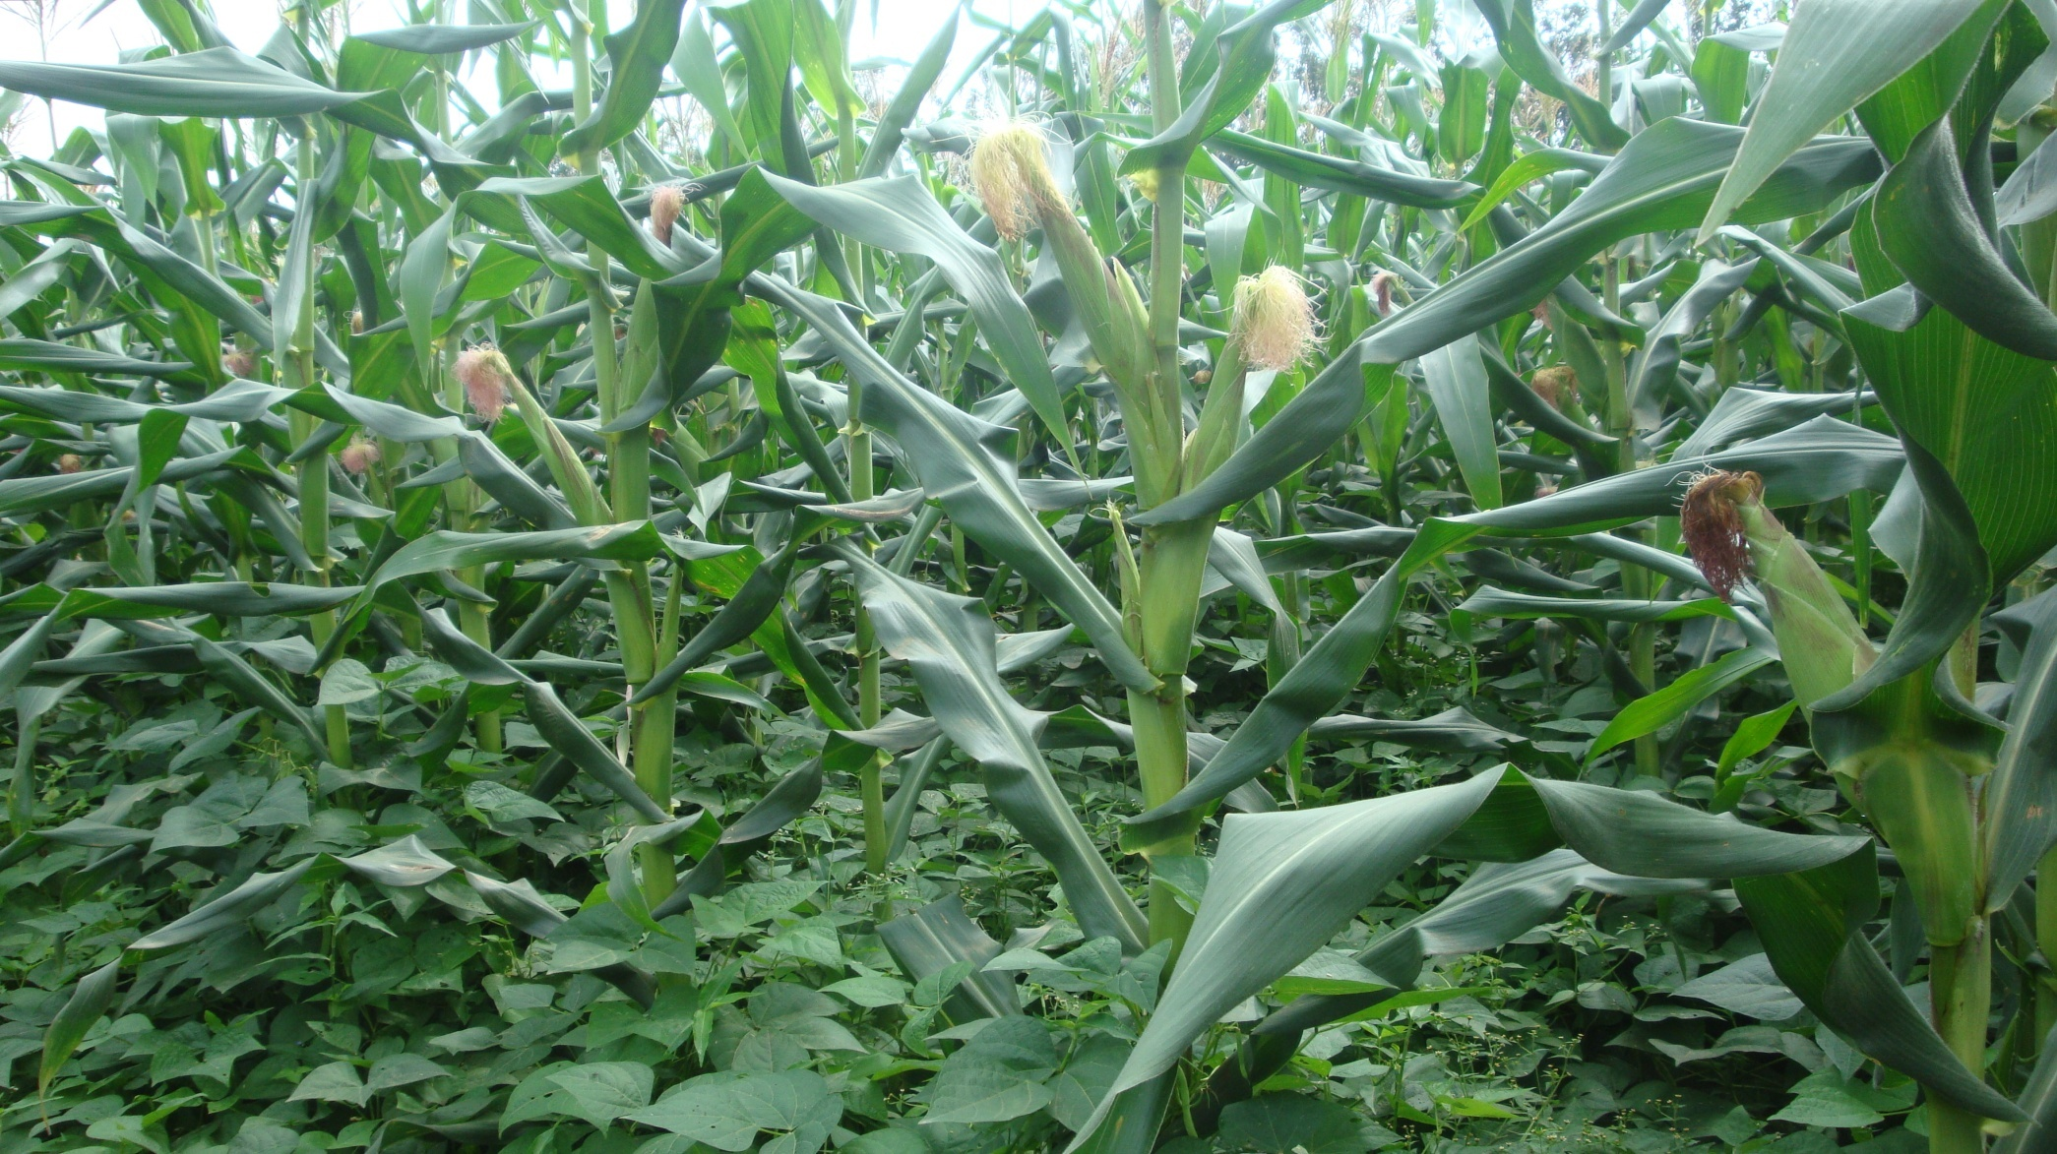
Sustainable Intensification Practices: Income and Food Security Opportunities for the Poor (SI 1+ SI 2 + SI 5)
Key findings
Combination generate more maize income than single adoption
Maize net income increases by 117-171% when improved maze varieties combined with other SIPs
Maize yield increases by 80-137% when fertilizer combined either with CD or MT or both (figure not reported)
Source: CIMMYT mimeo (2013)
Notes:
MT-minimum tillage and CD-crop diversification (maize-legume intercropping and rotations). Such kind of information will help in designing agronomy and breeding experiments and formulating extension messages.

Slide 25
Sustainable Intensification Practices: Cost saving Opportunity for the Poor (SI 1 +SI 2)
Malawi
N fertilizer (kg/ha)
Combination of SAI | Input subsidized farmer | Unsubsidized farmer
Intercropping + rotation +improved varieties | 15.91** | NE
Intercropping | 9.67*** | -2.02
Rotation | 10.66*** | -6.22
Improved varieties | 12.26*** | 6.09
Intercropping + rotation | 8.17** | NE
Intercropping + improved varieties | 10.08*** | -2.06
Rotation + improved varieties | 9.92*** | -5.11
Ethiopia
Combination of SAI | N application (Kg/ha) | Pesticide application (l/ha)
Rotation | 9.45 | 0.59
Improved varieties | 3.78** | 1.04***
Minimum tillage | -13.92*** | 2.95***
Rotation + improved varieties | 7.81 | 0.01
Rotation + minimum tillage | -19.95*** | 3.42
Improved varieties + minimum tillage | -5.60** | 0.84***
Rotation + improved varieties + minimum tillage | 15.27* | 1.49***
Key findings
SIPs either keep constant or reduced use of chemical inputs
In Malawi Subsidy seems to have a perverse effect on efficient use of inputs
Source: Ecological Economics (2013) 93: 85-93

Slide 26
Sustainable Intensification Practices: Insurance Opportunities for the Poor (SI 1 + SI 2)
SIPs reduce cost of risk but higher reduction achieved when SIPs adopted jointly (Malawi)
SIPs avoid the traditional high-risk, high-return (low-risk, low return) tradeoff
Source: Journal of agricultural Economics (forthcoming)

Slide 27
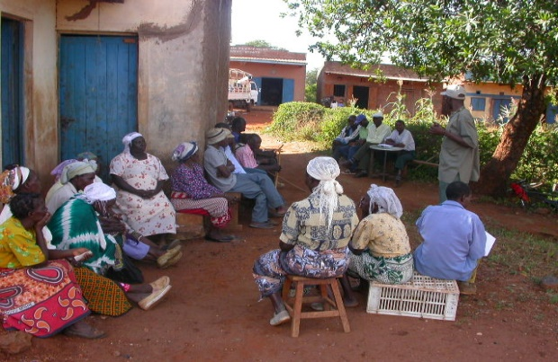
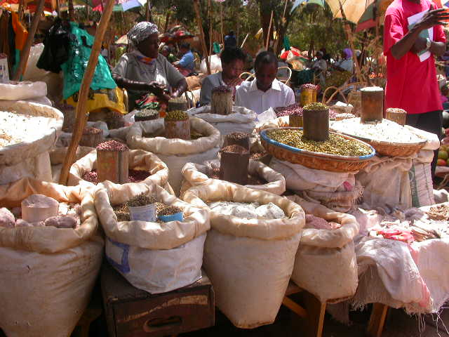
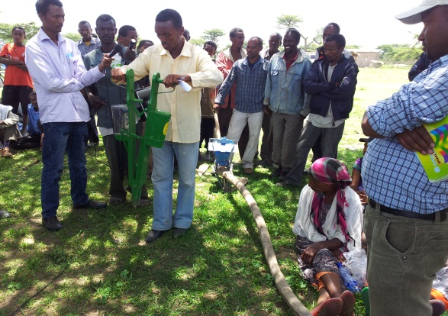
What Drives Adoption of SIPs?
Group Membership
Those farmers belonging to groups
had a higher chance to adopt:
In Ethiopia: Cropping system diversification(CD) and minimum tillage(MT)
In Kenya: Improved
  Varieties(IV) and fertilizer
In Malawi: Soil and Water Conservation(SWC)
Proximity to markets
When close to markets farmers had a higher chance to adopt:
In Ethiopia: CD and manure use
In Malawi: Improved varieties
In Tanzania: CD and MT
Household assets & extension skill
With more assets farmers had a higher chance to adopt :
In Ethiopia: Soil and Water Conservation
In Kenya and Tanzania: Manure
With quality of extension services farmers had a higher chance to adopt:
In Ethiopia: CD, MT,
In Kenya: CD and SWC
In Malawi: MT
In Tanzania: IV
Source: Land use Policy (2015) 42:400-411

Slide 28
From Results to Lessons: Implications
For many rural households, food security depends on productivity enhancement through improved maize varieties and SIPs
  For the foreseeable future: the pathway to food security will pass through smallholder productivity and technology improvement on own-farms
Need to expand the analytical frontiers of gender research in agriculture
  We find that latent and difficult-to-observe factors lie behind the gender food security gaps
Evidence exists for synergies in agricultural practices for SIPs
  Promising win-win outcomes
  But also suggesting greater role of information, extension and adaptive research

Slide 29
From Results to Lessons: Implications
Practices that conserve natural resources (moisture, soil, nutrients) also reduce costs of production
  Suggesting clear opportunities for sustainable intensification using “simple” techniques:
    Such as legume intercrops, reduced frequency of tillage
Risk is a major objective (perhaps co-equal to productivity)
  SIPs practices reduce downside risk
  Providing extra incentives for adoption
  The need for farmer education on these risk reduction benefits
Three classes of variables remain critical for SIPs adoption
  Social capital and networks (evidenced by group membership)
  Public goods in the form of infrastructure and extension
  Private asset endowments (land, equipment, livestock)

Slide 30
Next steps
Validate research products
Undertake various research issues
  Gender technology and productivity gaps and causes of these gaps
  Household bio-economic modelling
  SIPs and Risk analysis,
  Livelihood diversification
  Developing Women empowerment index, etc
Taking research products to policy makers, farmers, researchers, development partners, etc.,
Notes:
Publications are not results by themselves unless some of the actionable recommendations from our publications are adopted by researchers, policy makers etc.,

Slide 31
Thanks
Farmers
SIMLESA
AIFRC
ACIAR
Extension officer
Partners

Slide 32
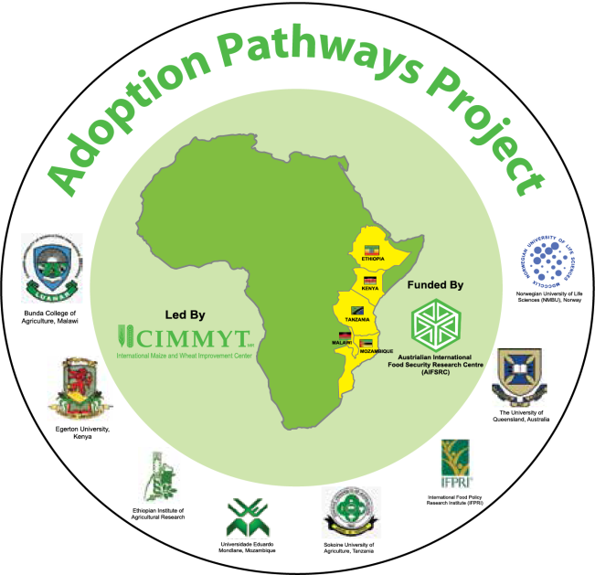
Thank you
m.kassie@cgiar.org

Slide 33
Adoption of Mechanization
Mechanization by agricultural activity (%hhld)
Activity | Kenya (N=513) | Tanzania (N=541) | Ethiopia (N=2258) | Malawi (N=732)
Land prepration | 11.8 | 22.4 | 1.6 | 0.1
Harvesting/threshing | 1.9 | 12 | 3 | 0.8

